Slide 1
Sequence to Sequence Modeling

Slide 2
Outline
Machine Translation
Embedding Layer
Projecting words in 2D space

Slide 3
Machine Translation
“Lets go”
“Tara”
“I am Elizer”
“Ako si Elizer”

Slide 4
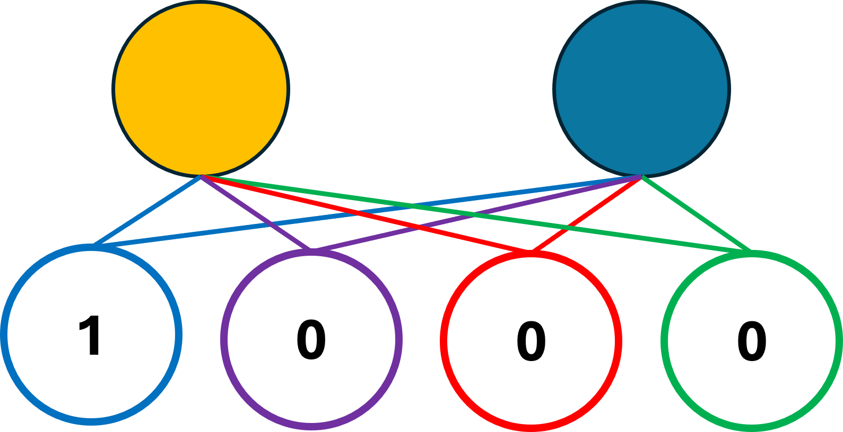
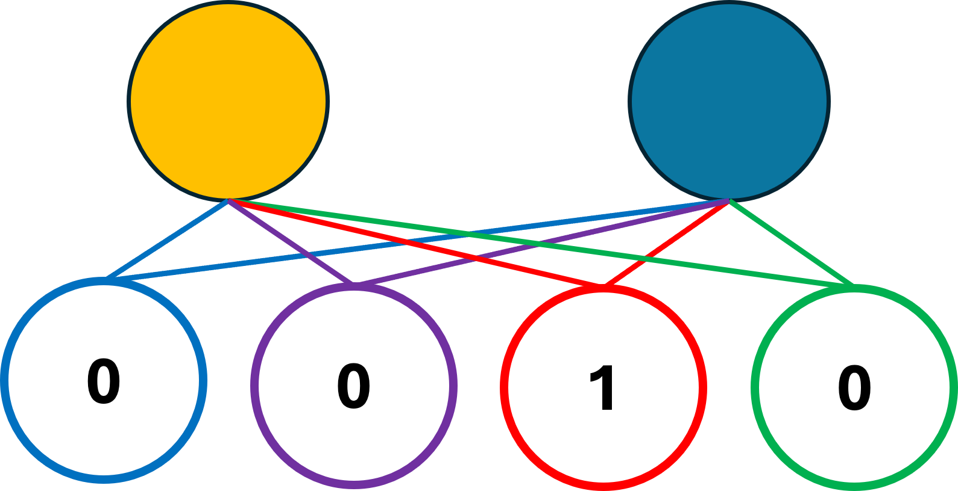
Lets
us
go
<EOS>
Lets
us
go
<EOS>

Slide 5
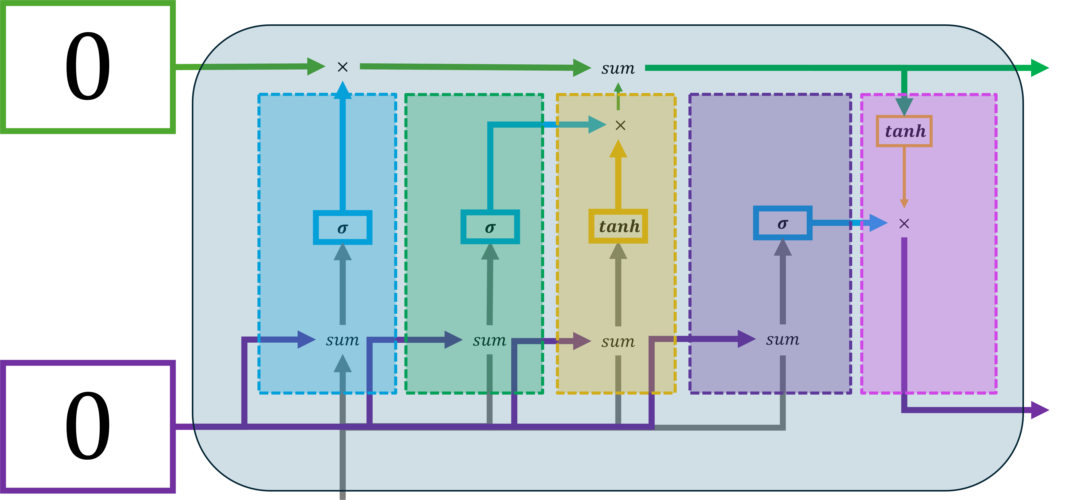
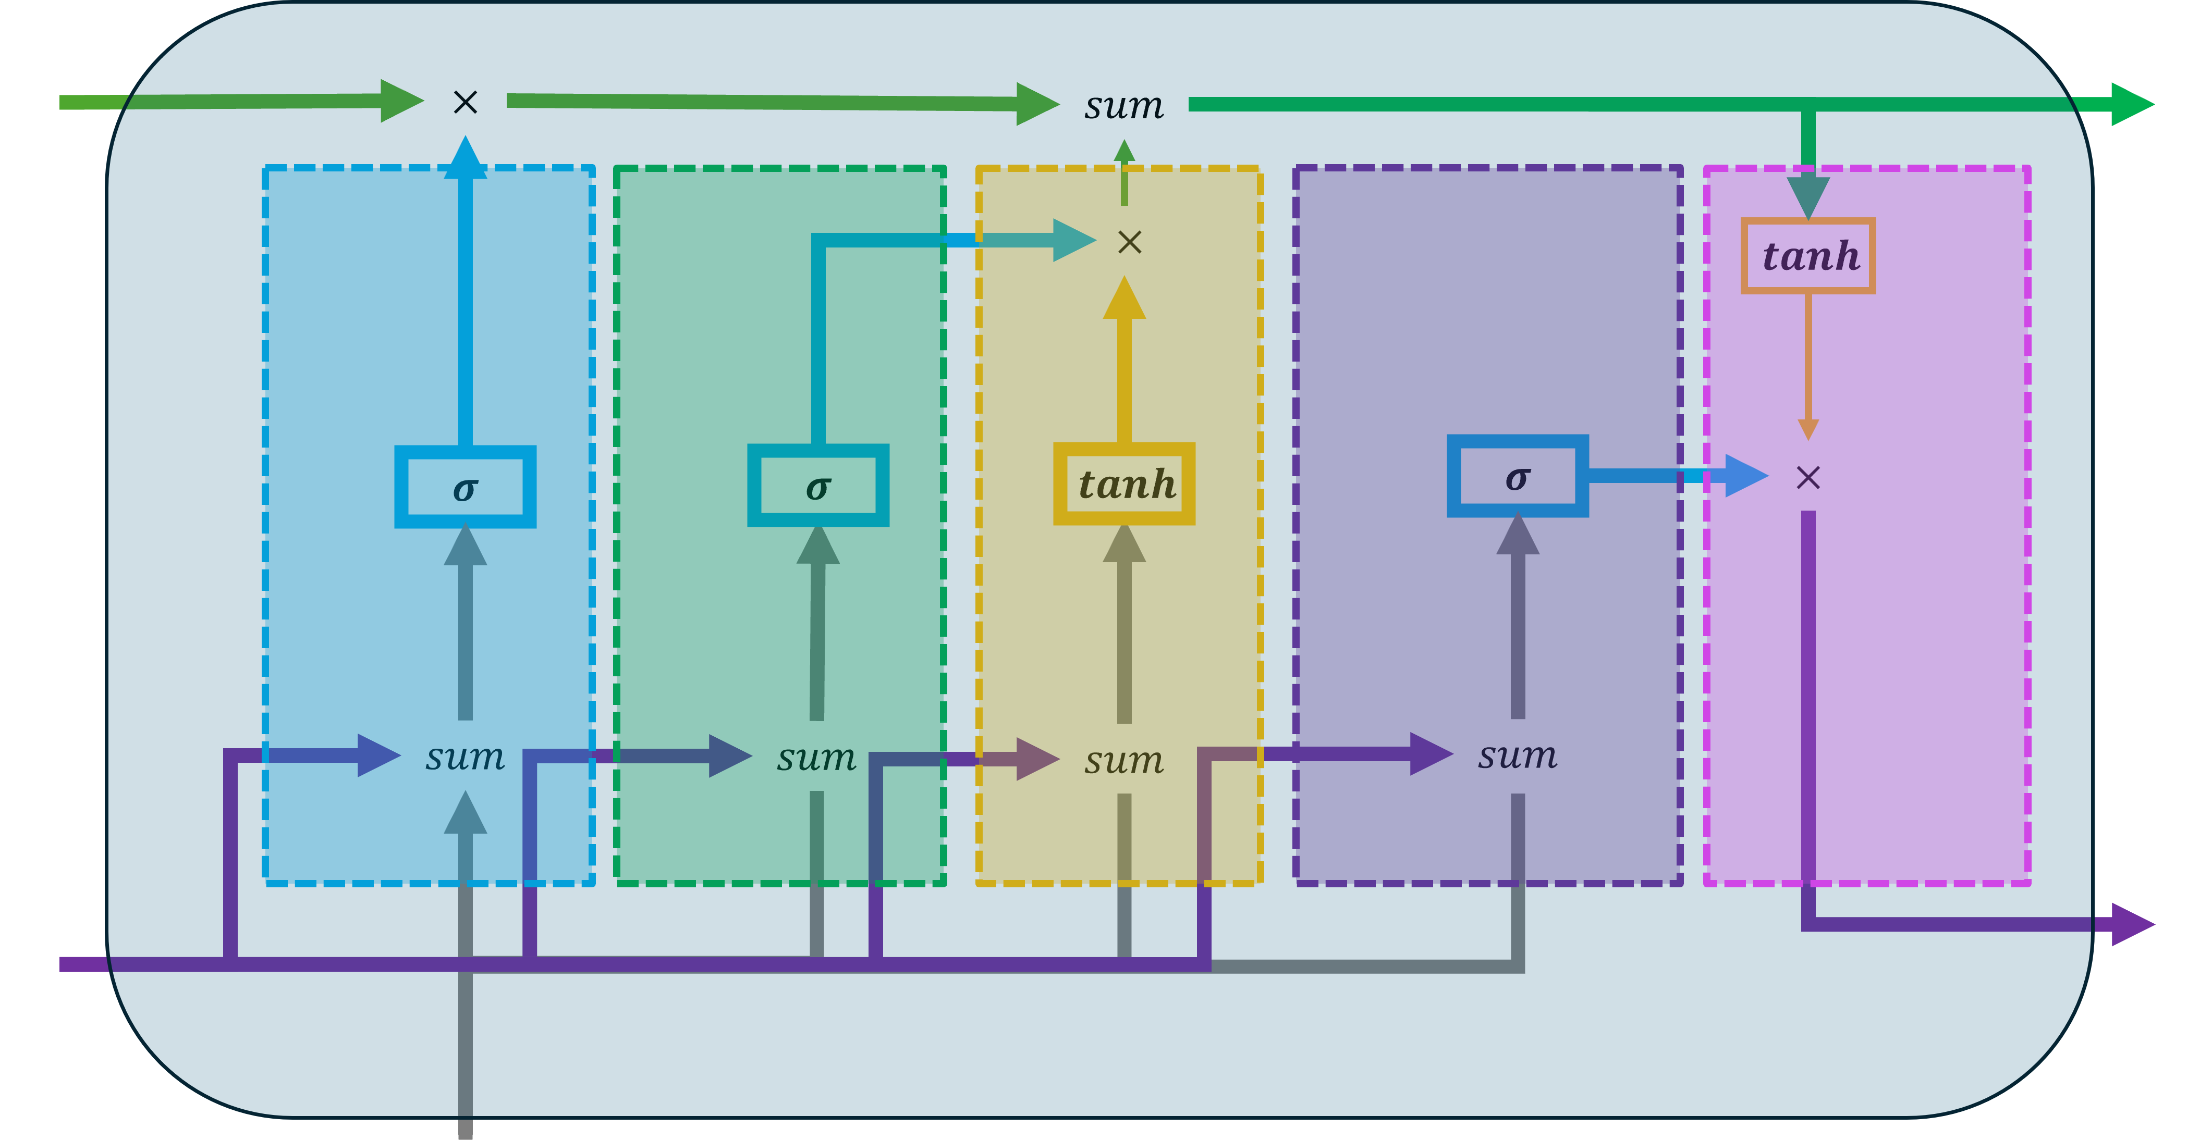
Lets
us
go
<EOS>
Lets
us
go
<EOS>

Slide 6
Lets
us
go
<EOS>
Lets
us
go
<EOS>

Slide 7
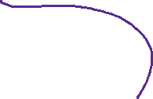
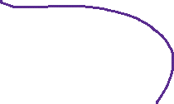
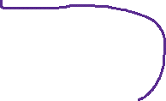
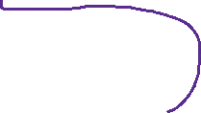
Lets
us
go
<EOS>
Lets
us
go
<EOS>

Slide 8
Encoder
Lets
us
go
<EOS>
Lets
us
go
<EOS>

Slide 9
Encoder
Lets
us
go
<EOS>
Lets
us
go
<EOS>

Slide 10

Encoder
Lets
us
go
<EOS>
Lets
us
go
<EOS>
at
Tara
ba
<EOS>

Slide 11
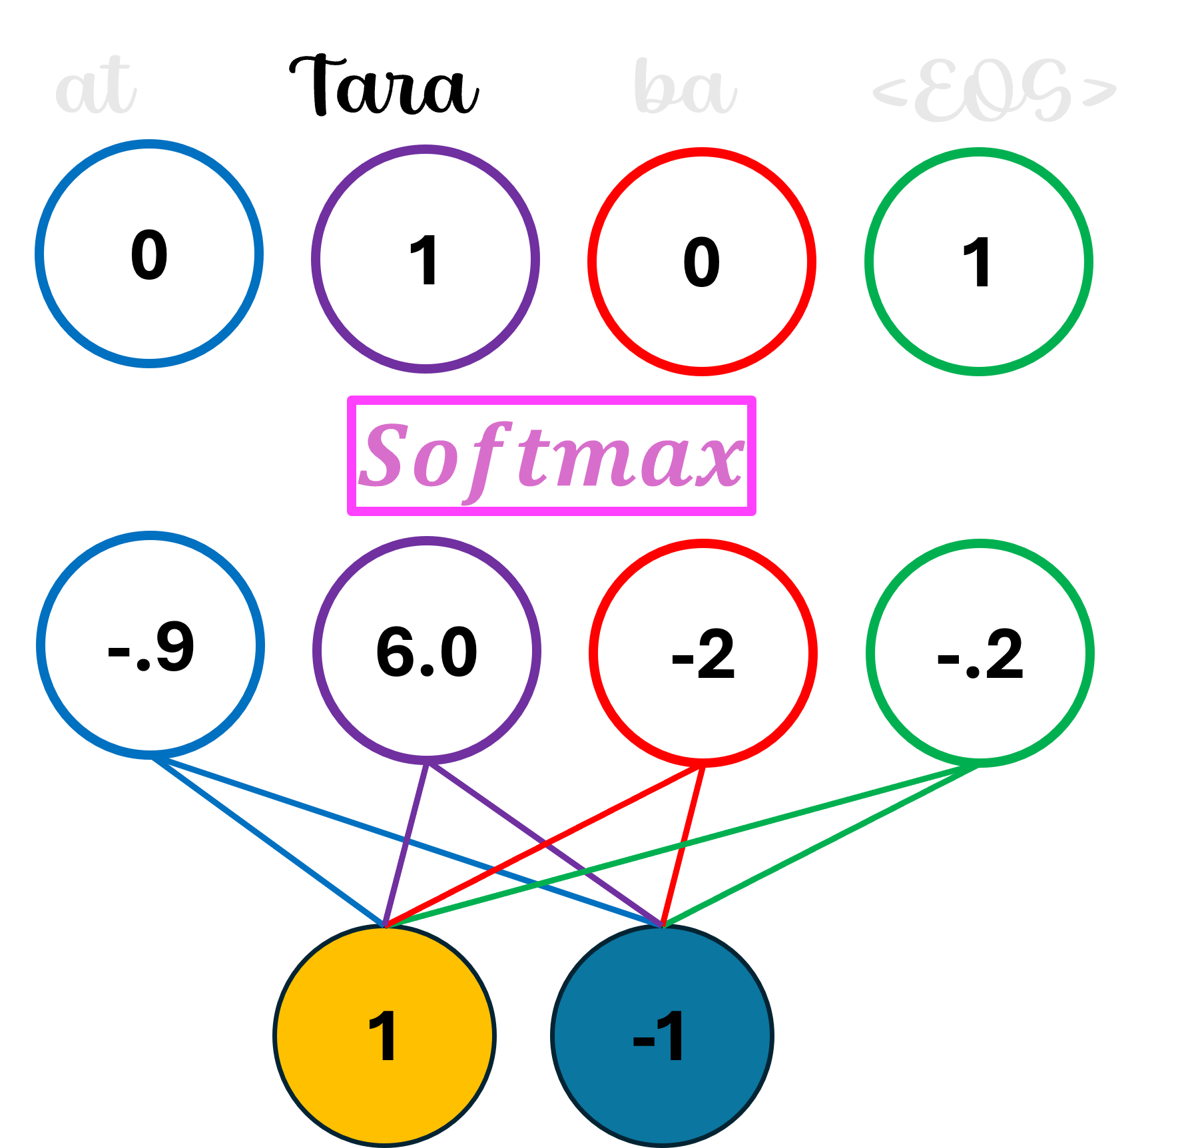
Encoder
Lets
us
go
<EOS>
Lets
us
go
<EOS>
at
Tara
ba
<EOS>

Slide 12

Encoder
Lets
us
go
<EOS>
Lets
us
go
<EOS>
at
Tara
ba
<EOS>
at
Tara
ba
<EOS>

Slide 13
Encoder
Lets
us
go
<EOS>
Lets
us
go
<EOS>
at
Tara
ba
<EOS>
at
Tara
ba
<EOS>

Slide 14



Encoder
Lets
us
go
<EOS>
Lets
us
go
<EOS>
at
Tara
ba
<EOS>
at
Tara
ba
<EOS>

Slide 15
Decoder
Encoder
Lets
us
go
<EOS>
Lets
us
go
<EOS>
at
Tara
ba
<EOS>
at
Tara
ba
<EOS>

Slide 16















$$0$$
$$×$$
$$sum$$
$$×$$
$$tanh$$
$$σ$$
$$σ$$
$$tanh$$
$$σ$$
$$×$$
$$sum$$
$$sum$$
$$sum$$
$$sum$$
$$0$$

Slide 17
$$×$$
$$sum$$
$$×$$
$$tanh$$
$$σ$$
$$σ$$
$$tanh$$
$$σ$$
$$×$$
$$sum$$
$$sum$$
$$sum$$
$$sum$$

Slide 18
0
1
0
0

Slide 19

at
Tara
ba
<EOS>
0
1
0
1
$$Softmax$$
-.9
6.0
-2
-.2
1
-1

Slide 20
at
Tara
ba
<EOS>
0
0
0
1
$$Softmax$$
-2
0.2
-2
6.5
0.9
0.8

